Slide 1

Introduction to Robotics
CSE 461
Lecture 1: Chapter 1(Introduction to robotics: basics)
Niloy Irtisam
Lecturer, Dept. of Computer Science and Engineering
Brac University

Slide 2
Marks Distribution
Quizzes/Class Tests: 15%
Attendance : 5%
Mid Term Examination: 20%
Final Examination: 35%
Lab: 15%
Project: 10%
Total: 100%

Slide 3
Syllabus
Chapter | Description | Class
1 . Robotics Basics | Definition of Robot, Robotics, Roboticity, Autonomy, Laws of Robotics, Types of robots, Paradigms, Subsystem | 1 - 4
2 . Introduction to Industrial Arm | Manipulator Types, Forward Kinematics, Inverse Kinematics | 5 - 8
3. Trajectory Planning and Wrists mechanism | Joints space, Linear Path Planning, Non Linear Path Planning | 9 - 10
4 . Control System | Types of Control, Block diagram solving, PID control, Fuzzy Logic Control | 11 - 13
5. Robot Navigation | Path Planning, Localization, Mapping, Exploration | 14 - 15
6 . Robot Learning | Machine Learning Reinforcement Learning Computer Vision | 16 - 18

Slide 4
What is a robot?

Slide 5
What is a robot?
An embodied agent that can be programmed to perform physical tasks.

Slide 6
What is a robot?
"A reprogrammable, multifunctional manipulator designed to move material, parts, tools, or specialized devices through various programmed motions for the performance of a variety of task."
[Robot Institute of America, 1979]
"An automatic device that performs functions normally ascribed to humans or a machine in the form of a human."
[Webster's Dictionary]
"a reprogrammable manipulator device"
[British Department of Industry]
"Robotics is that field concerned with the intelligent connection of perception to action."
[Mike Brady]

Slide 7
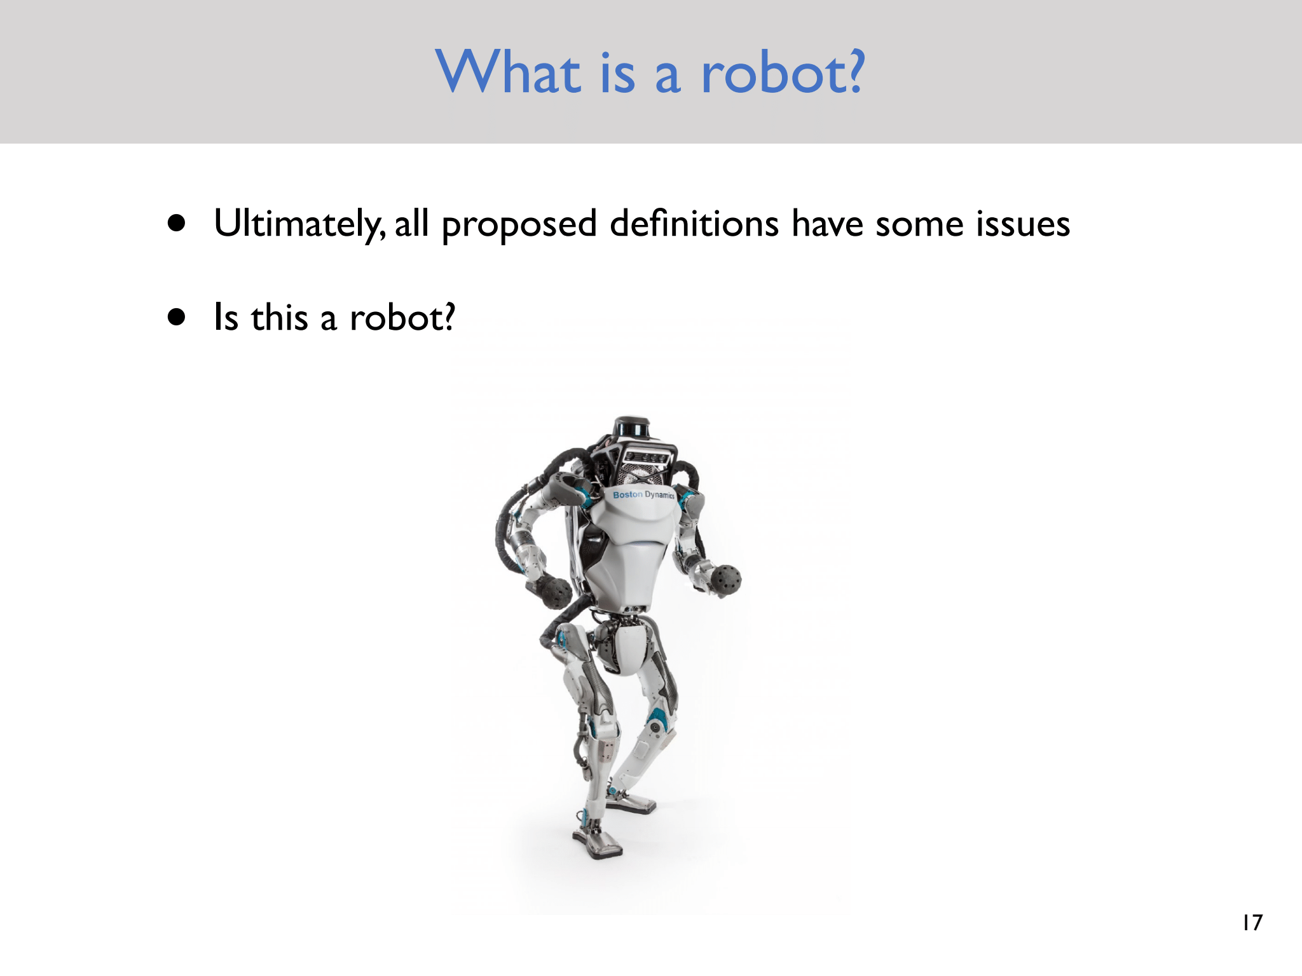

Slide 8
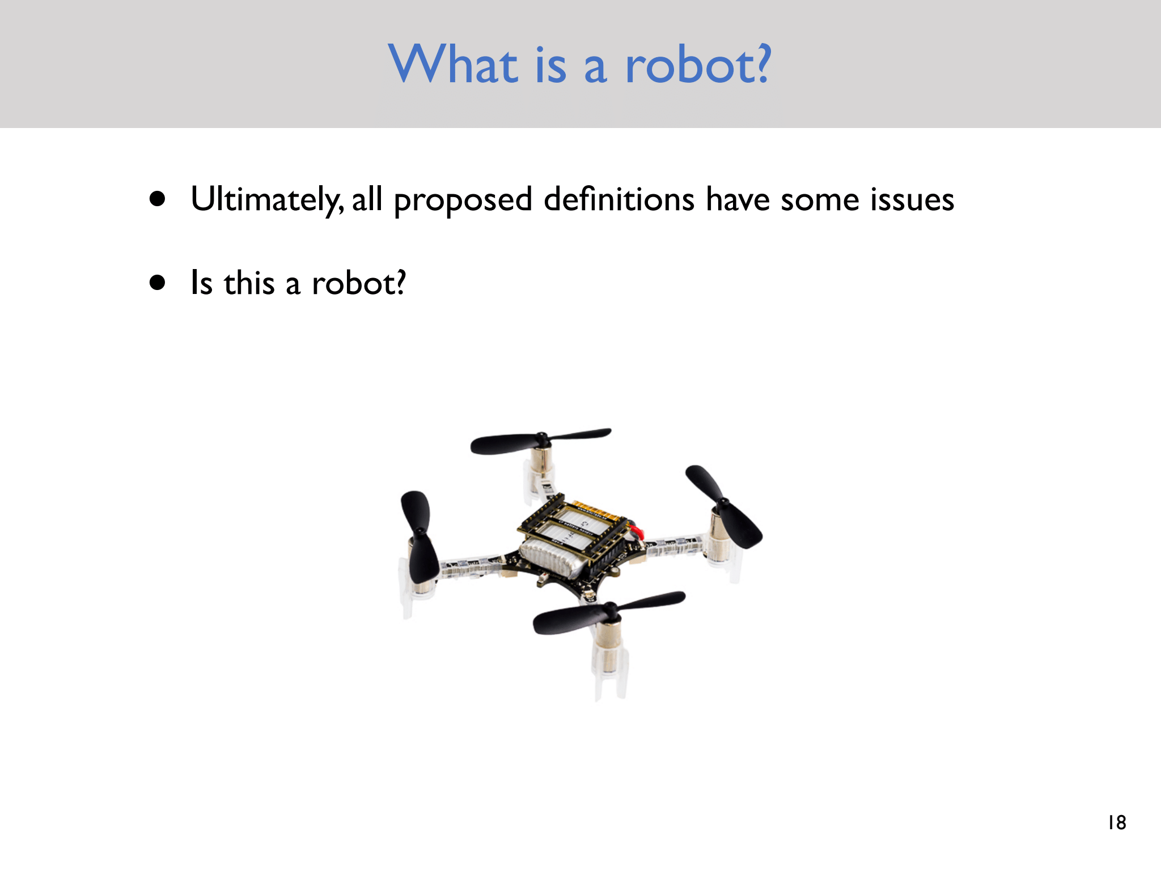

Slide 9
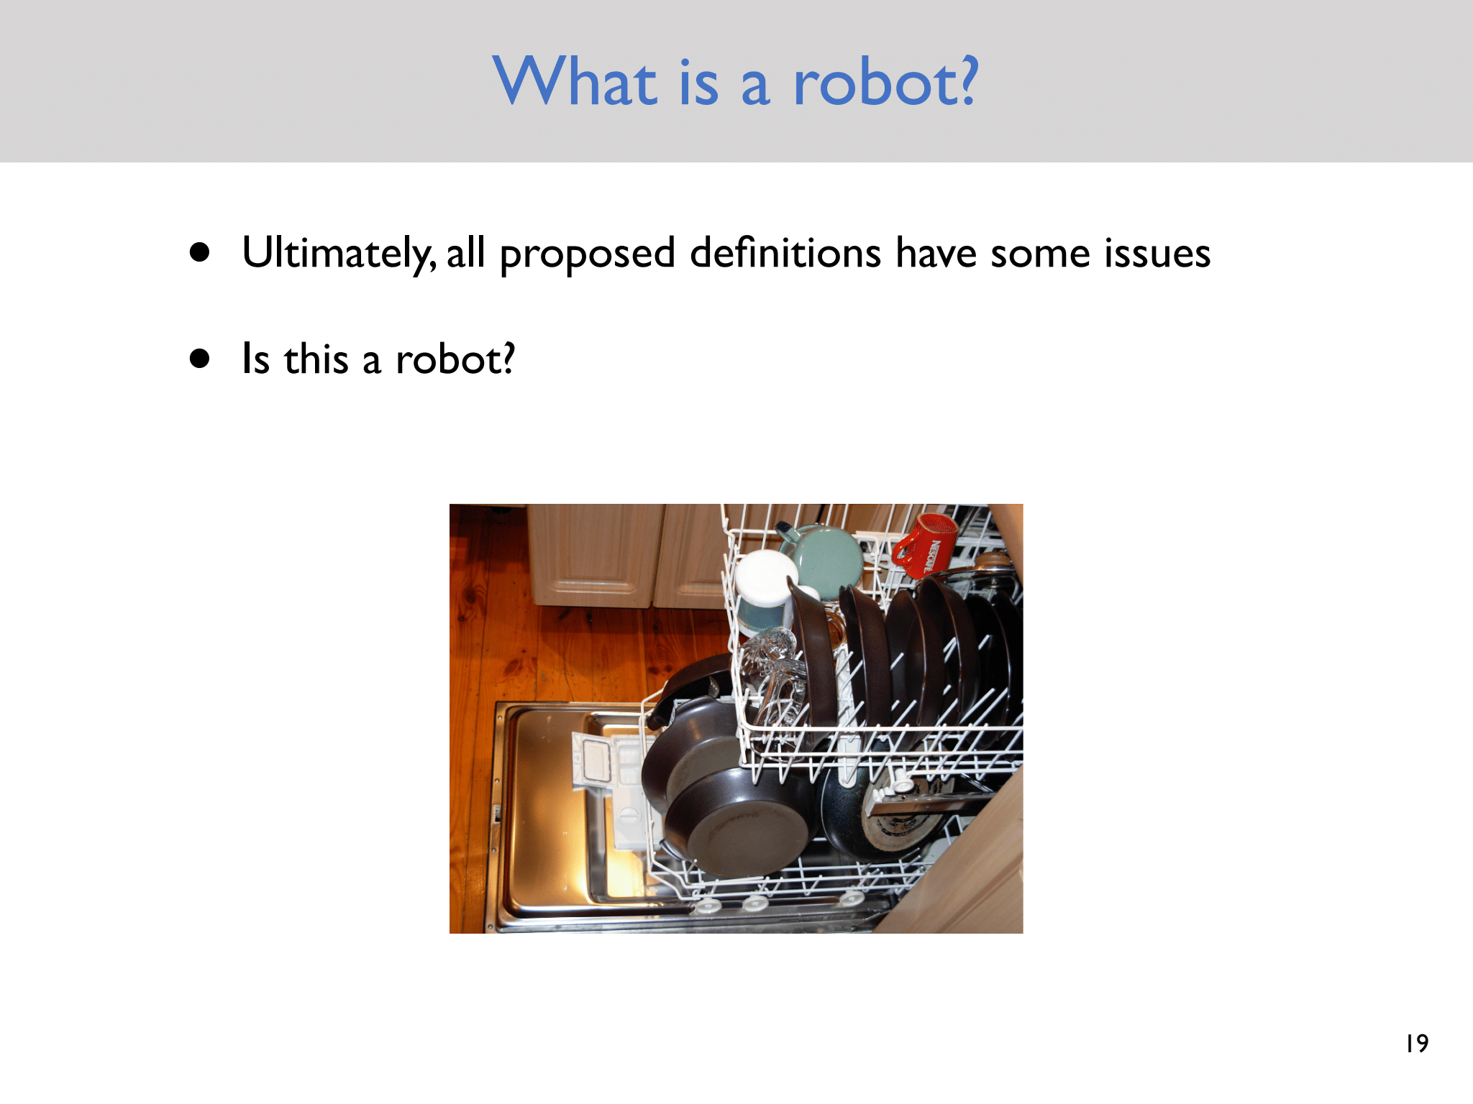

Slide 10
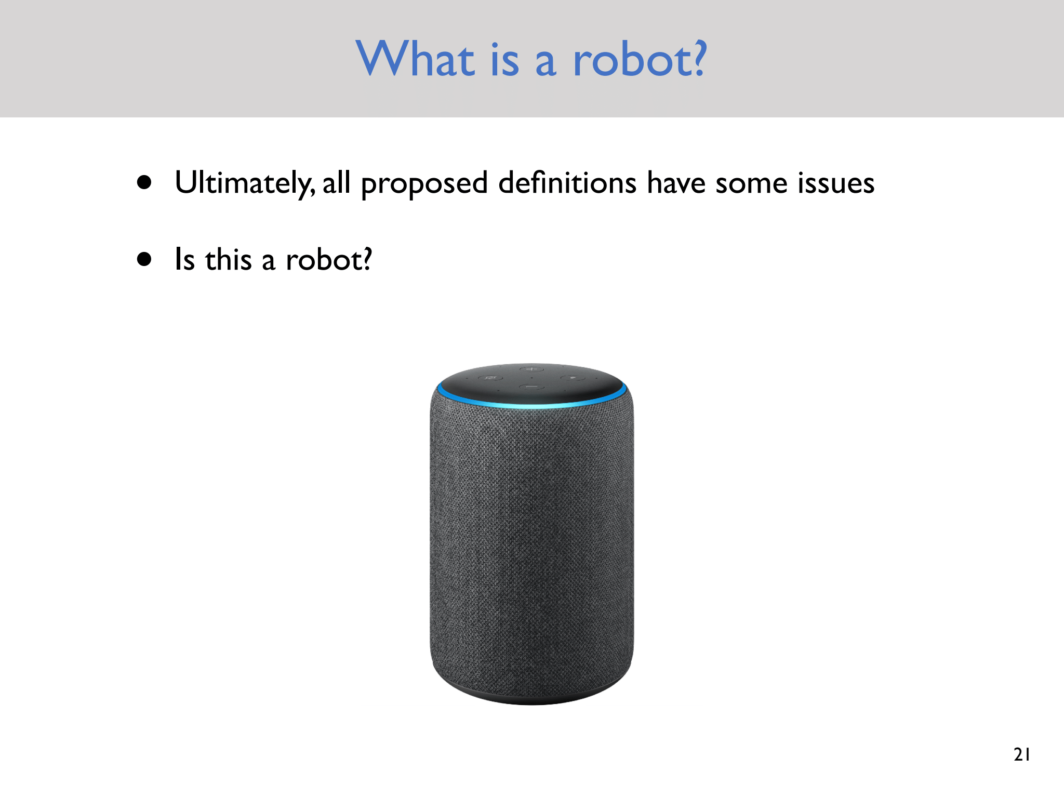

Slide 11
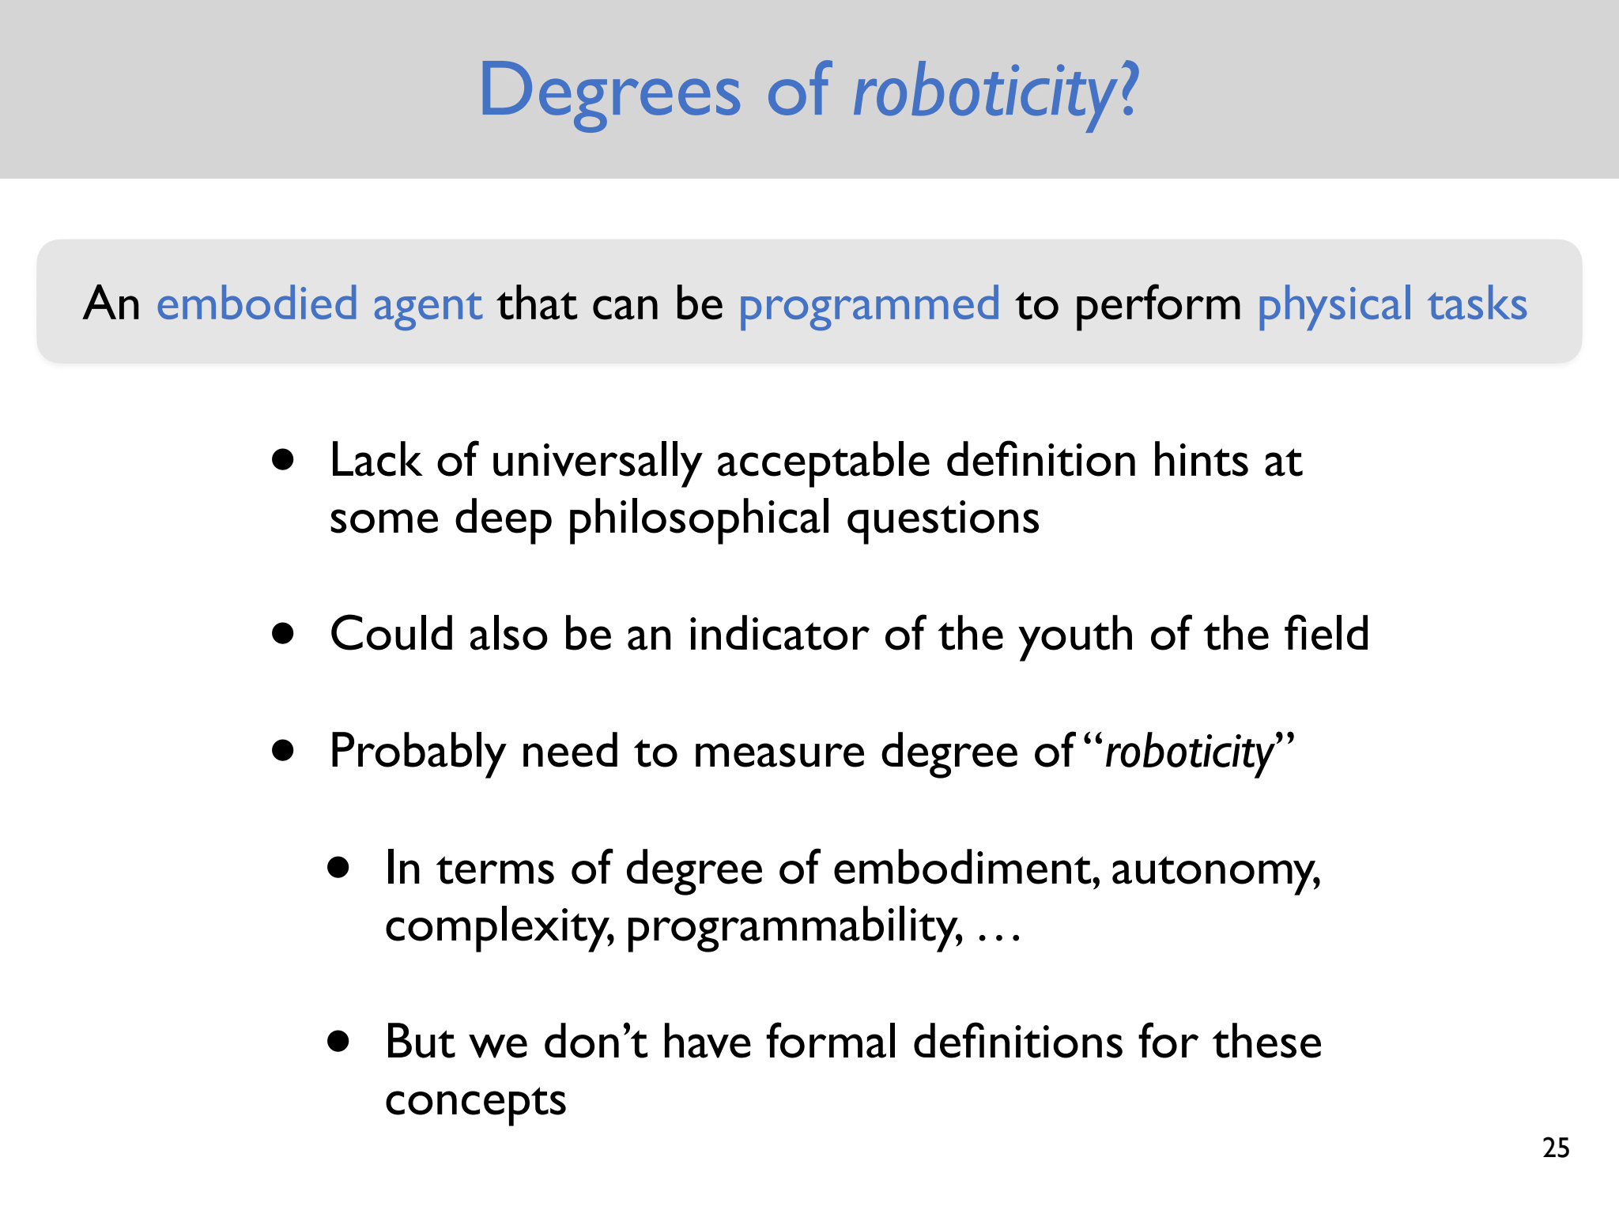

Slide 12
Robotics
Robotics is a branch of engineering and computer science that deals with the design, construction, operation, and use of robots.

Slide 13
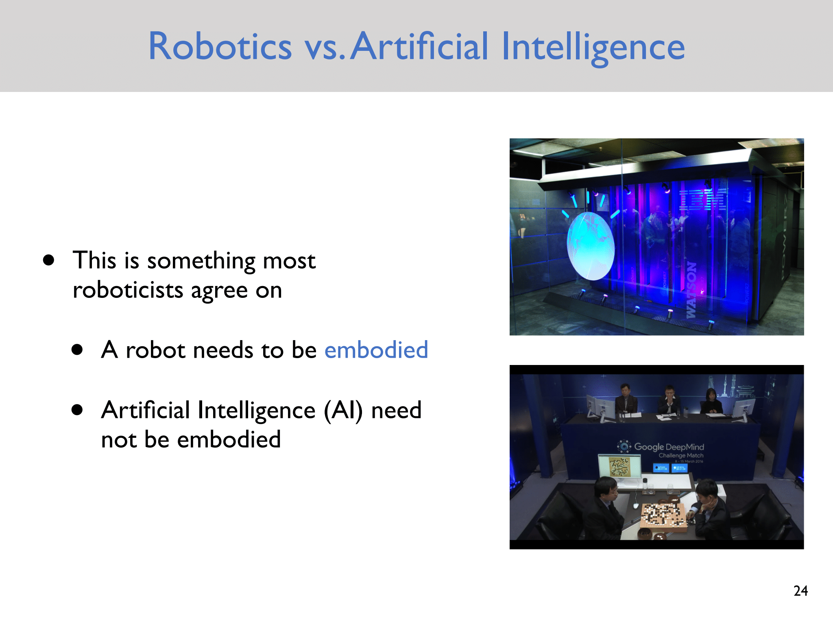

Slide 14
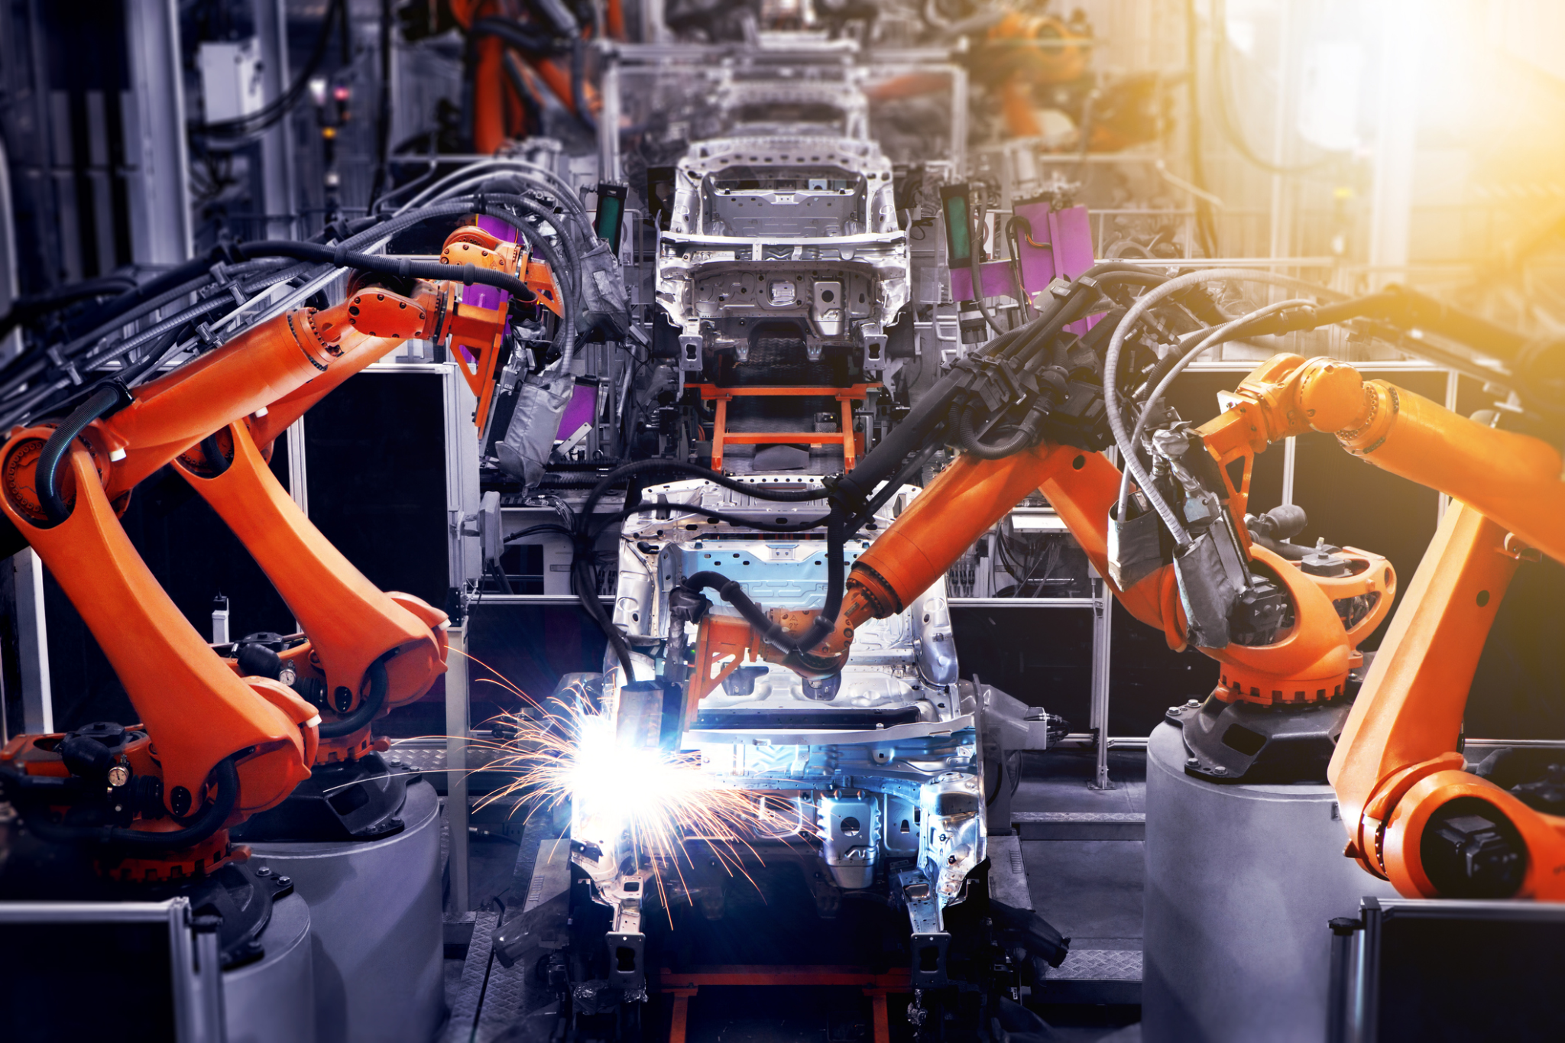
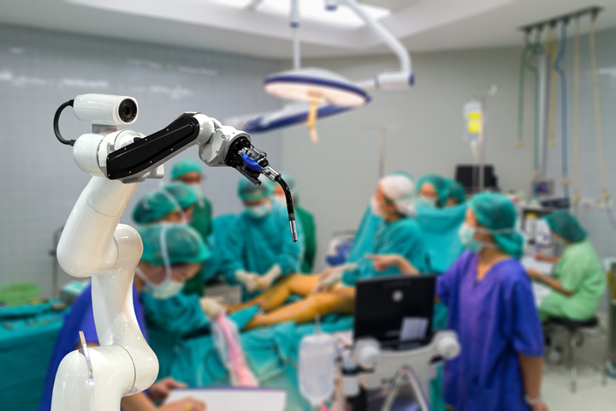

Slide 15
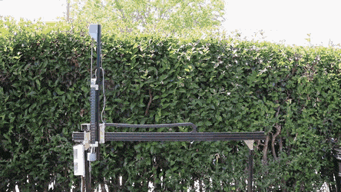

Slide 16
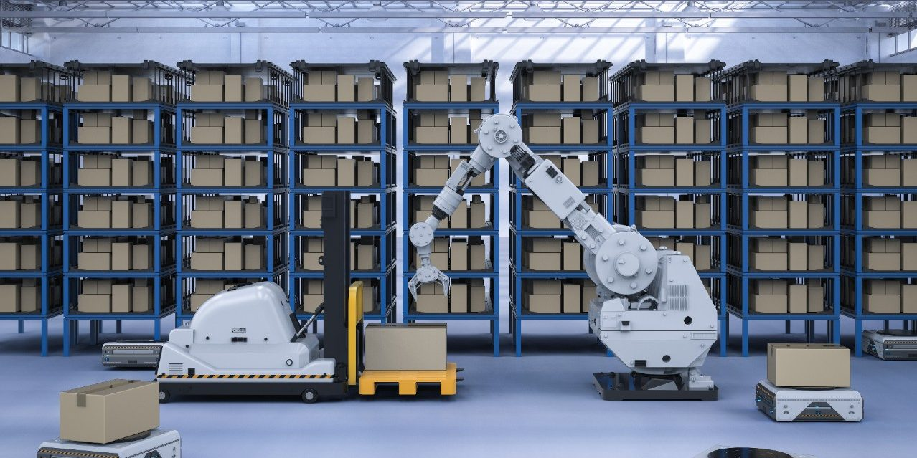
https://www.ubs.com/global/en/investment-bank/in-focus/research-focus/china-360/2020/warehouse-robotics.html

Slide 17
How Robots Are Used Across Industries
Industrial
Farming and Agriculture
Healthcare
Logistics
Family Robots

Slide 18
Think of some features for your own family robot !

Slide 19
Next Class
Laws of Robotics
Primitives
Paradigms

Slide 20
Thank You

